Slide 1
Congratulations DEAC 2024
Outstanding Graduates!!!

Slide 2
Redemption Seminary
Gregory Richardson
Masters of Arts in Biblical Studies
Gregory enrolled at Redemption Seminary as a non-traditional student since he was fully engaged in a cyber-security career for decades. He also had an interest in advancing his theological understanding at the graduate level. His presentation at the Society of Biblical Literature was transcribed by an AI-powered app that he designed, built and put to market, and has grown > 2000% in the past 3 months.

Slide 3
Nations University
Method Moyo
Master of Divinity
Method is the epitome of motivation. Despite the challenges of living and ministering in Zimbabwe, he has persisted in becoming a great scholar and practitioner. At the start of 2022, he took on the role of Ward Pastor at Cure Children’s Hospital of Zimbabwe, run by a Christian organization called Cure International. The hospital treats children with disabilities. His primary duty is to provide pastoral care to both the children and their caregivers.

Slide 4
Chi University
Tia Perry
MSTCVM, MSIVM-Ca, MSIVM-Eq
Dr. Tia Perry spent many of her early years immersing herself in animal care, focusing her studies on biology, animal husbandry, and health care. She began her integrative journey in 2017 when completing a certification in Canine Rehabilitative Therapy. After completing her multi-species acupuncture training in 2019, she established a solo mobile-only integrative practice and continued to expand her integrative training. She earned three master's degrees at Chi University in 2023.

Slide 5
Antioch School of Church Planting and Leadership Development
Femi Cakolli
Master of Ministry
While raising a family and engaging with national political and cultural leaders, Mr. Cakolli’s studies and work has allowed him to be part of a global learning community as well, taking the work that he has done with our organization and developing implementation strategies to encourage lifelong learning in others.

Slide 6
Sonoran Desert Institute
Owen Chambers
Associate of Science in Firearm Technology
Adopted from Thailand at 6, Owen embarked on a journey of adaptation and self-discovery upon moving to the United States. Growing up in Louisiana, he navigated linguistic and career challenges, eventually finding his passion for firearms. Owen enrolled in SDI, where he established a student-led Discord server that became a platform for connection and camaraderie. Motivated by this experience, Owen plans to launch a Black Rifle Coffee franchise, combining his passion for firearms with community outreach.

Slide 7
University of Management and Technology
Terrius Smith
MSIT
Throughout his academic journey, he maintained a competitive GPA, demonstrating his dedication and academic excellence. UMT provided the work-life balance Mr. Smith needed to achieve his personal, professional, and educational goals. His transition from military service to academia exemplifies resilience and determination. Following graduation, Mr. Smith leveraged his expertise by obtaining professional certifications in the Information Technology field.

Slide 8
Lakewood University
Amanda Dotson
Bachelor of Science in Paralegal Studies
Amanda Dotson, a dedicated military spouse, embarked on a remarkable educational journey at Lakewood University to ensure uninterrupted schooling amidst mandatory relocations. Her journey with Lakewood began in 2014 when she completed the Paralegal Diploma program. After a hiatus of five years, Amanda returned in 2020, showcasing her unwavering commitment. She not only earned an Associate and a Bachelor’s in Paralegal Studies but is currently pursuing an MBA at Lakewood University.

Slide 9
American College of Health Care Sciences
Bonnie Pearce
Master of Science in Herbal Medicine
ACHS courses led her to discover her love and knowledge of cultivating at-risk medicinal plants. Bonnie has her sights set on creating an education center and providing a space where the community can gather, learn, grow, and experience life with herbal medicine as the cornerstone. She is working with local investors and the local greenbelt association to acquire 50+ acres to become a medicinal sanctuary and school.

Slide 10
University of Arkansas Grantham
Cinderella Almond
MBA
Cinderella graduated from the University of Arkansas Grantham with a 4.0 GPA, and this provided her opportunities to apply for senior leadership positions within the Department of Defense and companies that provided services to Army, Air Force, Navy, Marines, and Coast Guard. Her new knowledge helped her to enhance her proven performance in management, leadership, and communication.

Slide 11
Harrison Middleton University
Audrey Rindlisbacher
Master of Arts
Audrey graduated Cum Laude with a 4.0 GPA. Audrey also launched a company called The Mission Driven Mom, an online academy for moms. In her academy Audrey teaches mothers to center themselves on principles, building a more solid foundation for their lives. Audrey is currently podcasting and posting on YouTube under her name "Audrey Rindlisbacher."

Slide 12
National Tax Training School
Kellin Ramirez
Federal Income Tax Course
Balancing the demands of parenthood with her aspirations, Kellin embarked on the tax course journey while finding time amidst her many responsibilities. Upon successfully completing the program, she secured a position as a tax preparer at a local office. Citing her diligence and competence, her employer eventually extended an offer for her to take ownership of the establishment. Kellin now stands as the proud owner of a tax preparation office in her hometown.

Slide 13
Cummings Graduate Institute
Heather Jelonek
Doctor of Behavioral Health
Dr. Jelonek spent two decades working in the healthcare industry before beginning the DBH program at CGI. After focusing a majority of her research on trauma and health equity, she used her culminating project to test the readiness of her state for implementing trauma-informed training across five provider networks.

Slide 14
Laurus College
James Holyfield
BA in Business Systems Management
Mr. James Holyfield is an individual who lives his life in gratitude every day, no matter what. His resume includes a wide variety of life experiences and adventures including: serving ten years in the United States Navy as a Hospital (Nurse) Corpsman; graduating from the prestigious Ringling Brothers Barnum and Bailey Clown College and performing as a professional clown; training in classical ballet at the John Barker School of Classical Dance Education in New York City; James’ passion for learning eventually led him to Laurus College where, at the age of 69, James earned his bachelor’s degree in Business Systems Management

Slide 15
Rockbridge Seminary
JD Lowrey
Master of Ministry Leadership
JD serves as the Student Ministries Pastor at Cornerstone Ministries in Murrysville, PA. His passion for ministry is to use his unique gifts and leadership abilities to help young people grow in their relationship to Christ. JD was a stellar student evidenced in his academic scholarship and his commitment to life long learning. JD seeks to use his unique gifts and leadership abilities to inspire transformation, cultivate genuine connections, and empower others

Slide 16
The Art of Education University
Karen Kelly
Masters of Art in Art Education
Karen Kelly consistently achieved top grades, demonstrating her passion and insight in art education, and her work exemplified a blend of creativity and academic rigor. Her selection for the prestigious Fulbright Scholarship, which will take her to Morocco, highlights her exceptional academic merit and aligns with her dedication to cross-cultural art education.

Slide 17
Anaheim University
Kashem Muttaqi
MBA in Global Sustainable Management
He currently serves as the Director of the Australian Research Council Training Centre in Energy Technologies for Future Grids and a Senior Professor at the University of Wollongong. Notably, in 2024 he attained fellowship with the Institute of Electrical and Electronics Engineers (IEEE), USA for his contributions to modeling and control of renewable and distributed energy resources.

Slide 18
Dunlap Stone Univeristy
Christian Pechhold
Bachelor of International
Trade Management
While working at Rolls-Royce, a condition of employment was earning his bachelor's degree. He sought a program that would accept credits earned in Germany, accommodate his busy career, and that was relevant to his field of work. In his position, Christian is responsible for export control and sanctions related issues for the Americas.

Slide 19
Penn Foster High School
Sidney Zaremba-Woodward
High School Diploma
Interested and passionate about activities such as basketball, martial arts, singing, and various styles of dance, Sydney was able to set up her own schedule with Penn Foster. She cites Penn Foster’s work-at-your-own-pace setup in helping to guide her to success. While balancing her other activities, including acrobatics, hip-hop, acting, ballet, jazz, and contemporary dance, Sydney applied herself diligently to her schoolwork. Her hard work paid off, as she was able to graduate at the age of 16 in the fall of 2022.

Slide 20
Gemological Institute of America
Linda Kozloff-Turner
Graduate Gemologist
Linda's career as a jeweler was abruptly put on hold after suffering a traumatic head injury in 2000. Creating jewelry became a deeply personal experience for her. Embracing the fragility of life, but determined to continue her craft, she opened Christine Marguerite Designs in 2005, a retail jewelry company dedicated to employing local talent and committed to ethically sourced supplies.

Slide 21
Genesis University
Rachel Shechter
Bachelor of Arts in Education & Religion
Rachel's educational journey epitomizes unwavering dedication and an unyielding pursuit of excellence. Her fervent passion for teaching and commitment to cultivating dynamic learning environments were evident from the outset. Driven by a vision to master her field, Rachel enrolled in GenesisU, pursuing her Bachelor of Arts in Education and Religion, graduating Magna Cum Laude, showcasing exceptional academic talent. Her journey seamlessly integrated her interests in Jewish Studies and Education. Rachel's relentless pursuit of knowledge led her to obtain her M.S. in Jewish Education and Special Education. With a wealth of knowledge and a profound understanding of her craft, she embarked on a fulfilling career path, inspiring students in elementary and high schools alike.

Slide 22
Ashworth College
Garrick Haynes
MBA
Developing skills and gaining knowledge in areas where he is passionate has helped Garrick succeed. Currently, he is the CEO of a technology company, Jobrielle Corporation, and is pursuing a new path as a motivational/inspirational speaker. He is currently working towards publishing a series of books that he has written regarding this career choice.

Slide 23
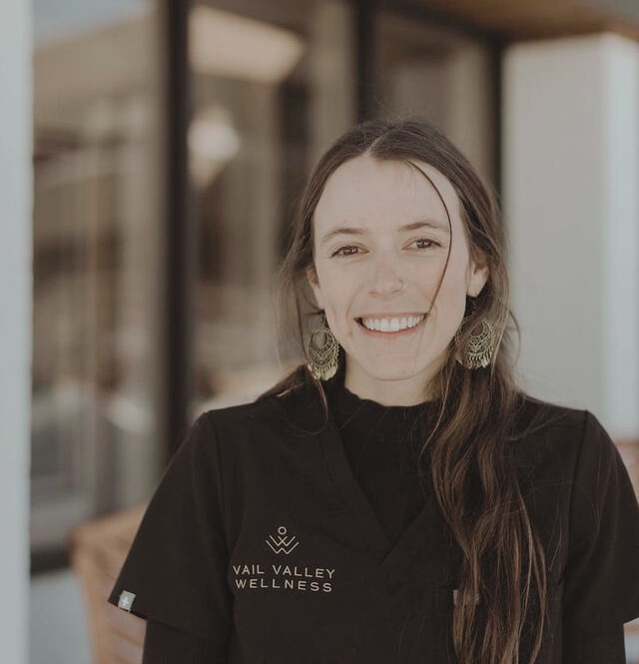
DEAC
FAMOUS ALUMNI
2024

Slide 24
American College of Healthcare Sciences
KAITLYN MUSICK
AAS, Integrative Health Sciences, 2022
“The skills learned at ACHS allow me to provide a holistic approach to my community by providing diet, physical activity, stress, and emotional health management guidelines. My experience at ACHS is at the forefront of my own lifestyle habits and all that I offer to my clients.”
A health practitioner at the Vail Valley Wellness Clinic, Kaitlyn is able to combine both Eastern and Western medicine by incorporating tinctures, teas, salves and more for clinic clients. She hosts a weekly community gathering called “Healthy Happy Hour,” which provides a safe space for its members to socialize and bond through healthy physical activities. She has also worked with fire departments in her area to bring acupuncture and holistic modalities to team members experiencing high-stress levels.

Slide 25
William Carey International University
TODD JOHNSON
MA AND PHD, 1993
“My WCIU education gave me the tools I needed to develop and utilize innovative methods to assess religious affiliation in every country of the world. WCIU prepared me for a lifetime of research and teaching on global Christianity and world religions.”
Dr. Johnson is the Eva B. and Paul E. Toms Distinguished Professor of Mission and Global Christianity, and Co-Director of the Center for the Study of Global Christianity at Gordon-Conwell Theological Seminary. Johnson is visiting Research Fellow at Boston University’s Institute for Culture, Religion and World Affairs leading a research project on international religious demography. He has published encyclopedias, atlases, databases, monographs, and scholarly articles on counting religionists around the world. He teaches Masters and Doctoral level courses at GCTS and BU.

Slide 26
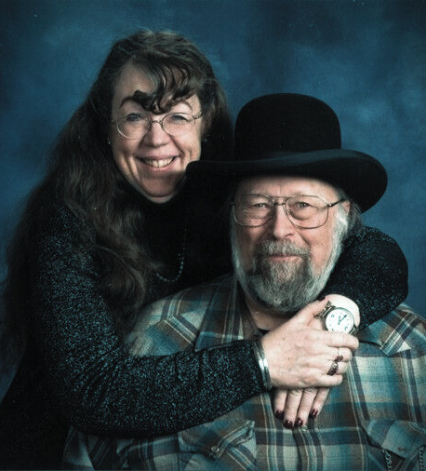
National Tax Training School
RICHARD HARDESTY
FEDERAL INCOME TAX COURSE, 1989
Nan Hardesty completed the tax course in 1983 and, singing its praises, encouraged Richard to complete his in 1989. Together they founded Rising Wolf Tax Preparation reaching over 200 clients in Northwestern Montana. Nan passed away in 2022 after 32 years in the tax preparation field. Richard retired in 2024.
“Nan prepared my tax return and reviewed it with me, showing how I qualified for a refund. I was very impressed so I asked her how she’d learned to do taxes. She told me all about National Tax Training School.

Slide 27
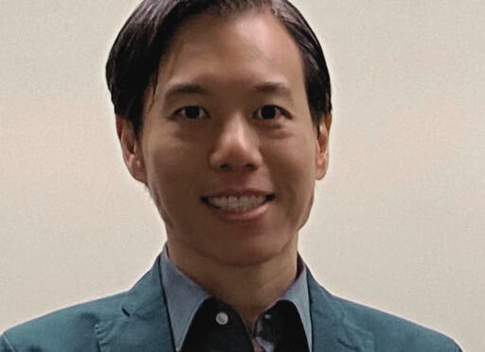
University of Management and Technology
SZE CHUN TSANG
Dr. of Business Administration, 2014
Dr. Tsang has a manufacturing business in China. He aspired to pursue a doctorate degree in business administration to enhance his skills at operating the business. After comparing programs offered by on-campus universities, he chose the DBA program at UMT because of its flexibility and the richness and diversity of the subjects offered. Dr. Tsang also holds four other degrees from the University of Hong Kong, the University of Chicago, and the University of California, Irvine. Dr. Tsang, together with several UMT graduates in Hong Kong, established the UMT Hong Kong Alumni Association
“Pursuing the DBA program offered by UMT is one of the best choices I've made because its flexibility has allowed me to fulfill a long-time goal”

Slide 28
DEAC
Famous
ALUMNI
2024

