Slide 1
DEAC 2025 Awards Program
Congratulations to Outstanding
Graduates and Famous Alumni!

Slide 2
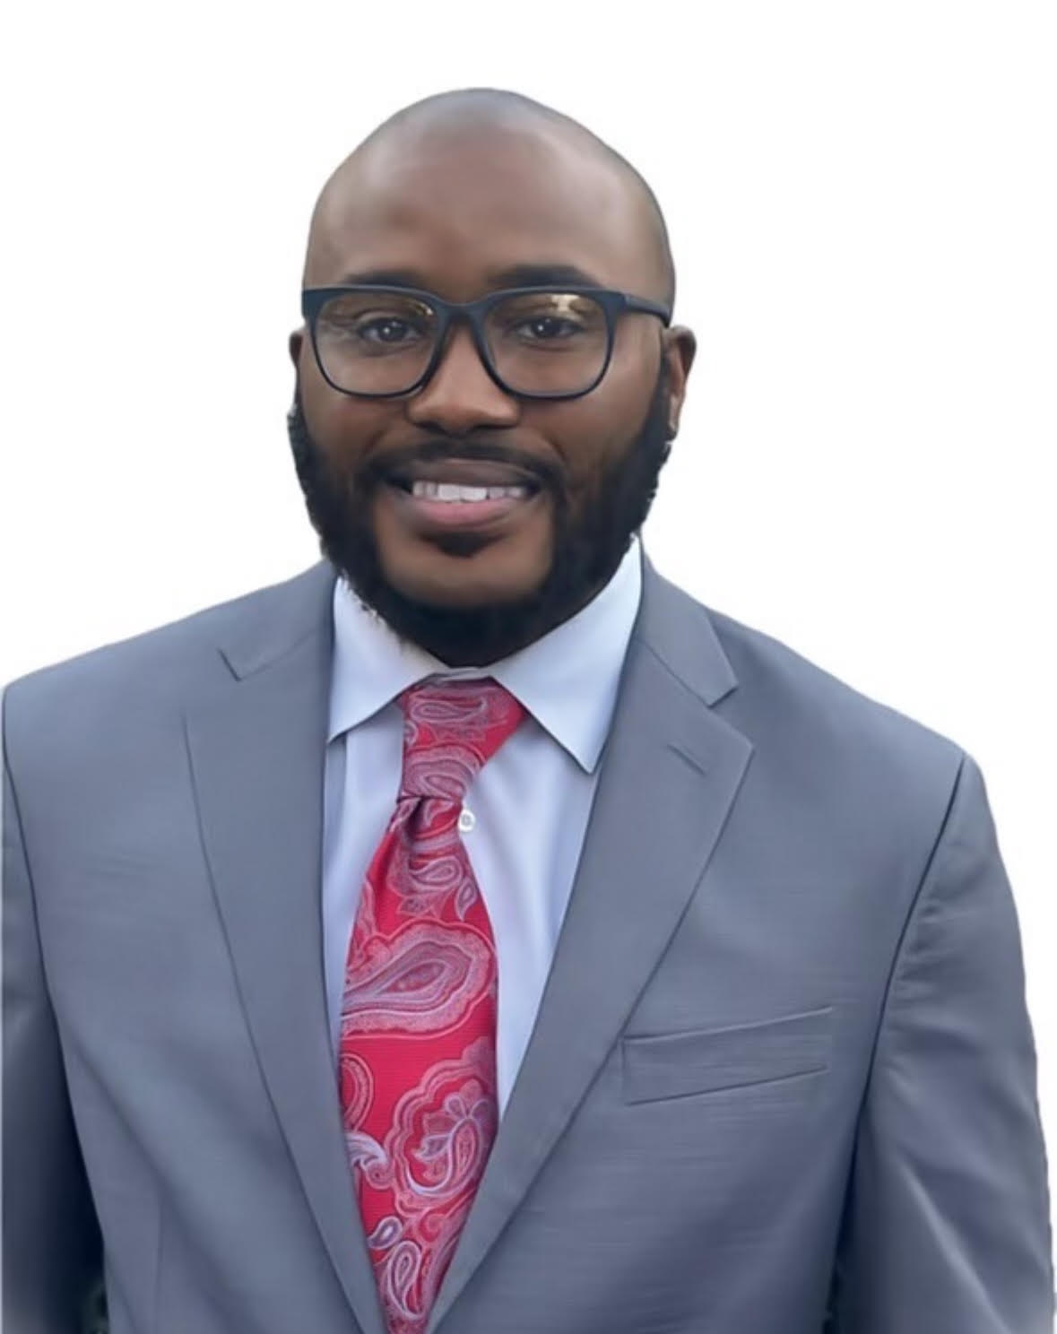
Mose Perkins V
University of Arkansas - Grantham
"There were moments when I felt overwhelmed, exhausted, and ready to give up. The support I received from my professors, fellow students, and military comrades was invaluable. Their encouragement and understanding helped me stay motivated and focused, even during the toughest times. Their belief in me fueled my determination to succeed, no matter the obstacles I faced.
Through perseverance and hard work, I not only earned my degree but also grew as a person. My experience at UA Grantham taught me that with dedication and resilience, anything is possible.”

Slide 3
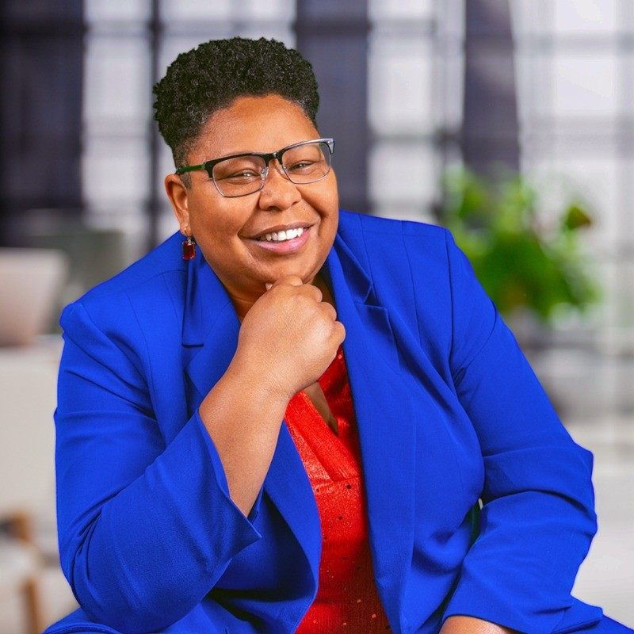
Dr. Brandy Biglow
Cummings Graduate Institute of Behavioral Studies
"My mission is to empower you to design YOUR life of H.A.R.M.ON.Y., a life that keeps you inspired, fulfilled, and healthy both at work and home."

Slide 4
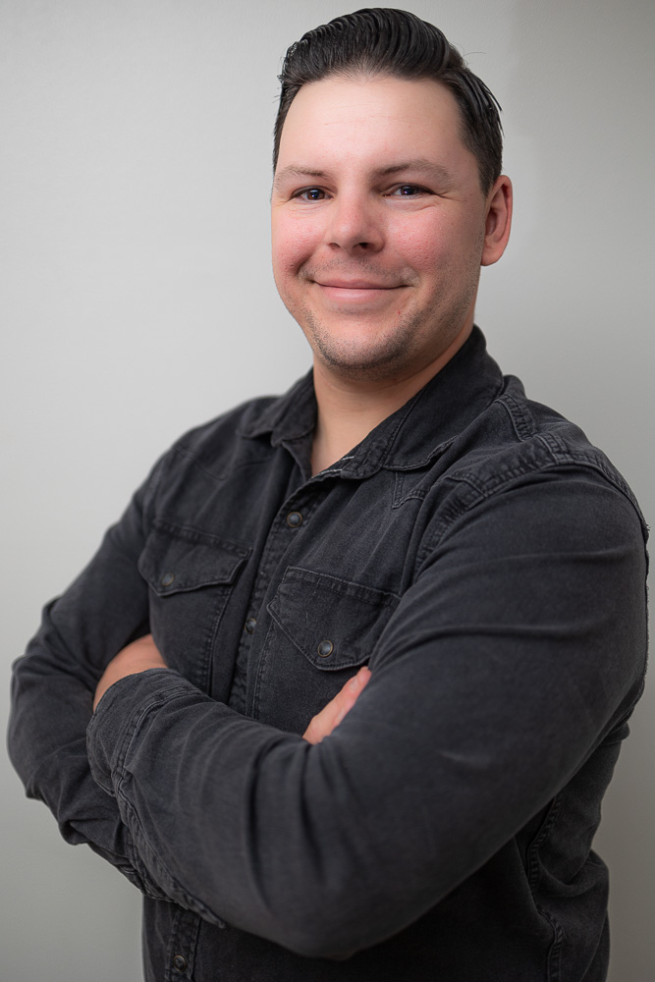
Aaron Mittan
Sonoran Desert Institute
“Success isn’t measured by personal achievement alone—it thrives in equipping others with the knowledge, confidence, and skills to take control of their future.”

Slide 5
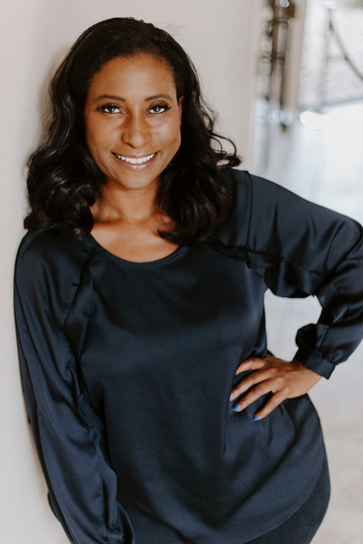
Dr. Marie Teilhard
Harrison Middleton University
“Lifelong learning has always been my passion. I chose Harrison Middleton for the intimate academic environment and the ability to study at my own pace. HMU faculty and staff provided superior instruction; my education was filled with lively and provocative academic exchanges.”

Slide 6
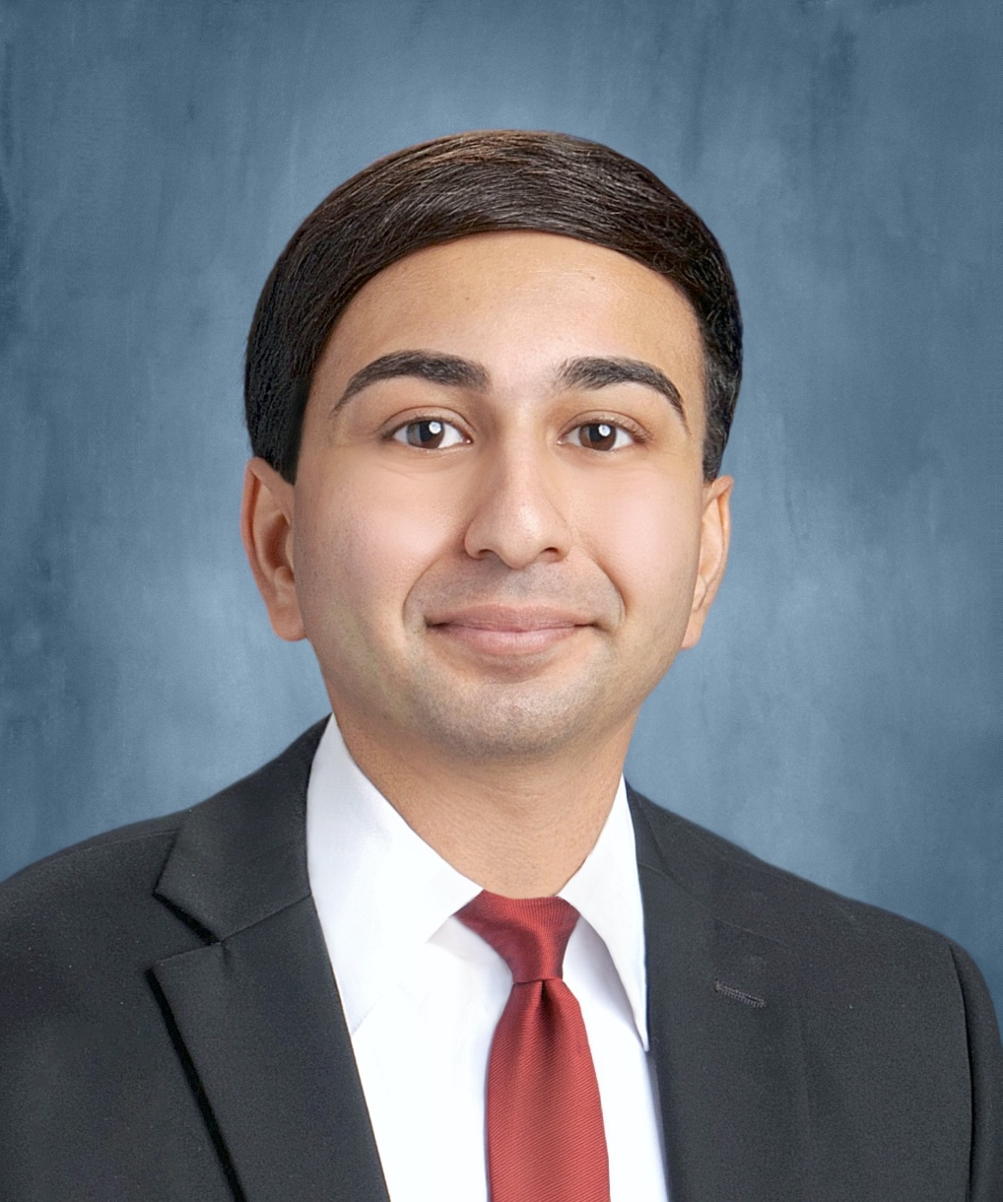
Yuvraj Verma
Taft University System
“Without a doubt, my calling is to continue to serve and benefit the lives of children! My personal experiences coupled with my strong academic experiences, including at William Howard Taft University, have helped me become strongly-equipped to do this very rewarding, humbling, and much-needed service work.”

Slide 7
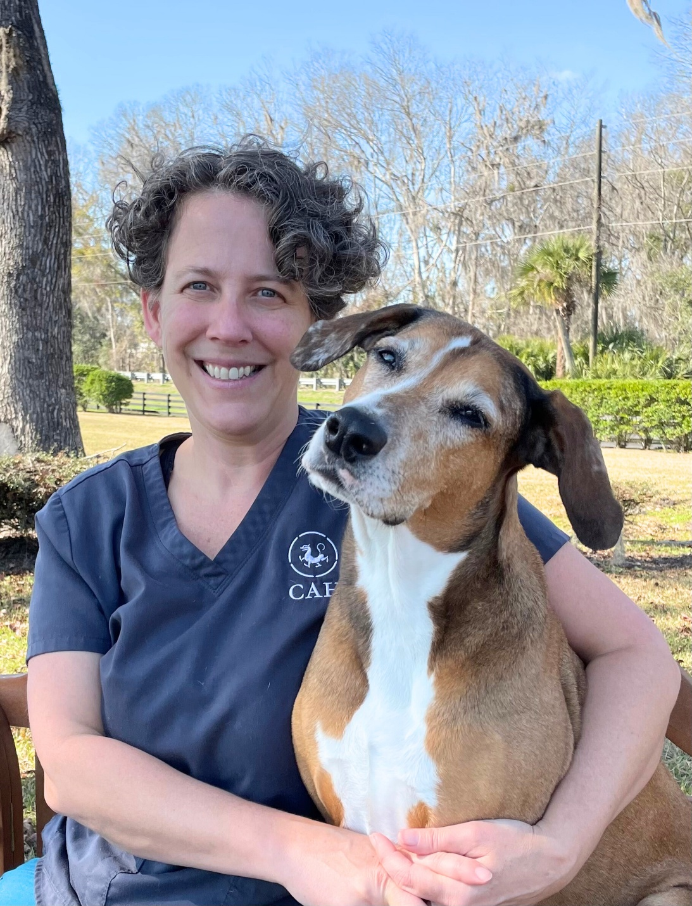
Dr. Terri Rosado
Chi University
“Chi University has been my educational home for the past 20 years. As I have grown through their teachings, I’ve had the honor to watch the University expand its educational opportunities to more and more veterinarians throughout the world. Through all this time I have observed nothing short of educational excellence and unparalleled faculty support. Through the MS-TCVM program, I have gained knowledge and skills that not only help my patients, but that I can share with colleagues the world ‘round. I am humbled and honored to be a student and instructor at Chi University.”

Slide 8
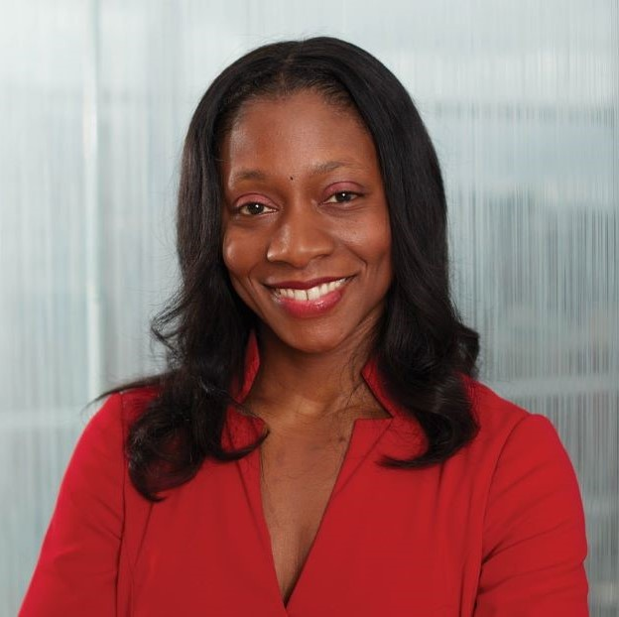
Fatima Cody Stanford
Quantic School of Business and Technology
“Throughout my career, I have been driven by a passion to educate and advocate for patients, empowering them with knowledge and compassion. I strive to dismantle the barriers of stigma and shame that have long overshadowed this condition, replacing them with empathy and scientific understanding. By fostering a more informed and accepting perspective, I hope to inspire a broader societal change that acknowledges the complexities of obesity and supports individuals in their journey toward health and well-being.”

Slide 9
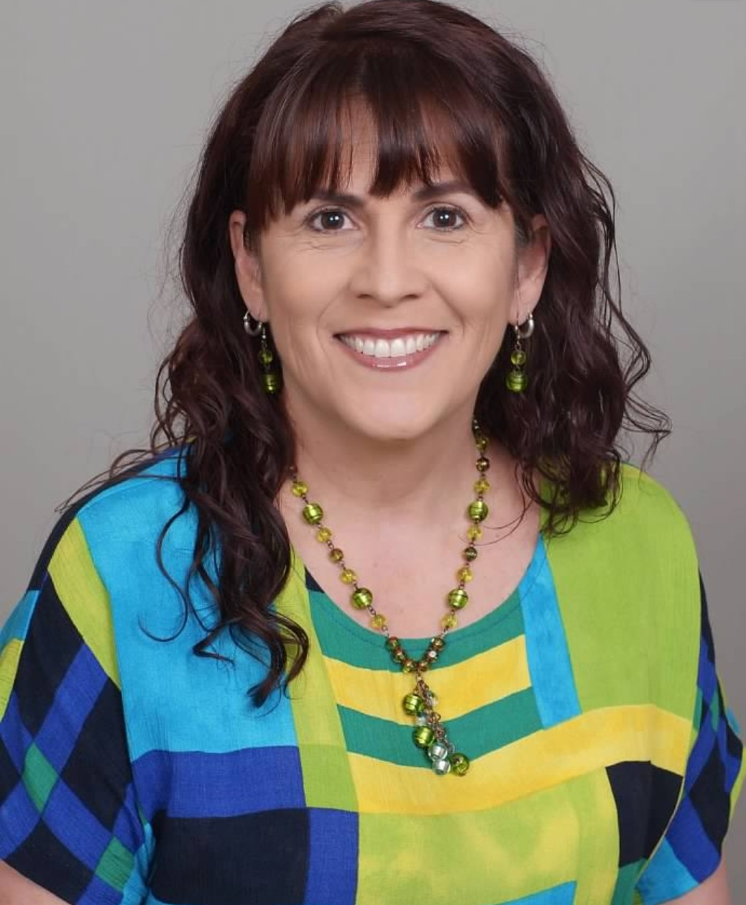
Paolla Jordan
Lakewood University
“Lakewood University empowered me with the education and confidence to take my passion for mediation to the next level. Every dispute is an opportunity for resolution, and every person deserves to be heard. In every difficult circumstance, there is a silver lining. This is something I share with all those I serve to empower them so that they don't remain stuck. It is an honor to serve others. We walk together, not alone.”

Slide 10
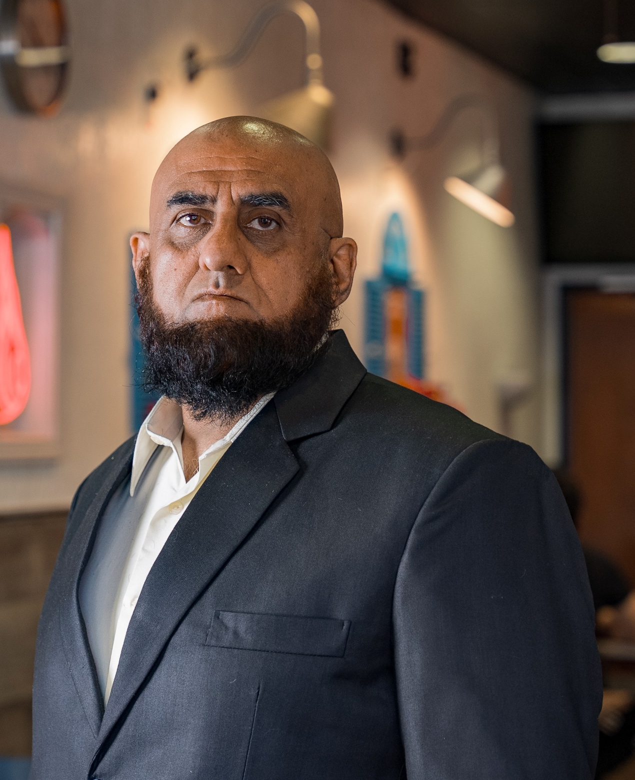
Sajad Shakoor
Western Institute for Social Research
“Education not only helps us recognize our God-given human potential but also empowers us to explore, realize, and harness it—transforming ourselves into agents of change in service to humanity.”

Slide 11
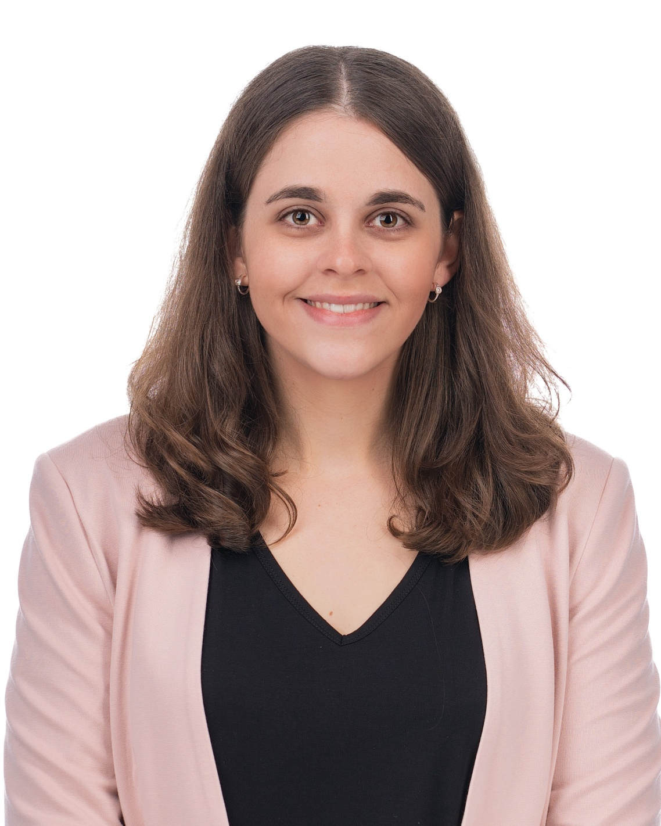
Jordyn Zimmerman
Quantic School of Business and Technology
“Exclusion is a feeling that everyone knows or can relate to. When people are excluded by any design at all, it contributes to a piece of our belonging in the world. In contrast, when we have access to innovative tools or opportunities that enable connection and belonging, it's often life changing. So I hope to continue making our communities more accessible and inclusive, especially for those of us who are historically left out of spaces, products, and conversations.”

Slide 12
Gaby Hagler
Quantic School of Business and Technology
“Success isn’t about choosing one path—it’s about building bridges between them. Growth happens when we stay curious, challenge assumptions, and embrace the unexpected intersections where innovation and transformation thrive.”

Slide 13
Angelica Torres
Doral College
“Teaching is more than a profession—it’s a calling. Every child deserves a champion, and I strive to be that person in my classroom every day. Doral College gave me the tools to turn my passion into purpose, and I am forever grateful for the impact it has had on my journey.”

Slide 14
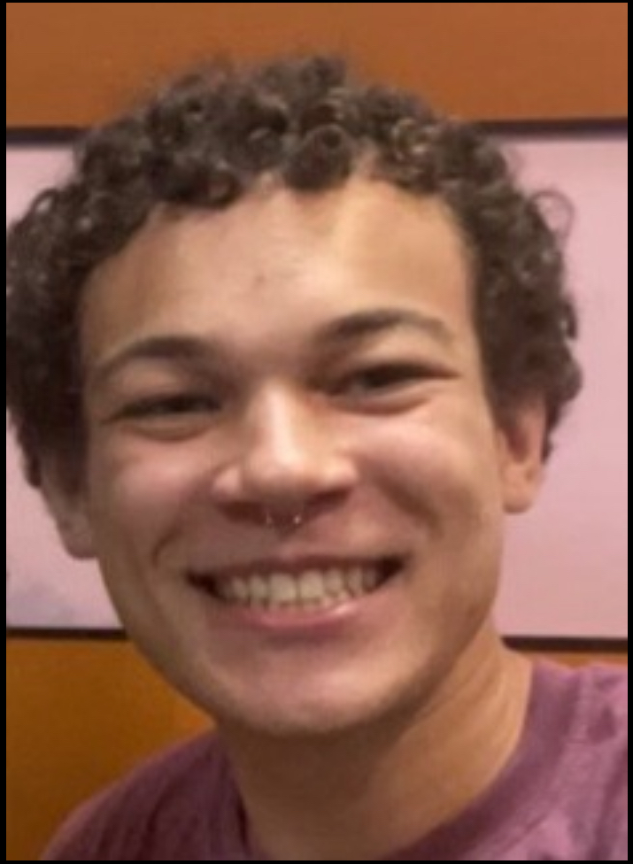
Thomas Kelley
Citizens High School
“School isn’t just about graduating—it’s about finding a way to make it work for you. Once I had the flexibility and support I needed, everything changed. Success is about having the right opportunities and making the most of them.”

Slide 15
Rev. Amanda Blue
Clinical Pastoral Education International
“CPE was a life-giving experience. It pruned me in a way that allowed me to become much more productive, producing healthy fruit in my ministry.”

Slide 16
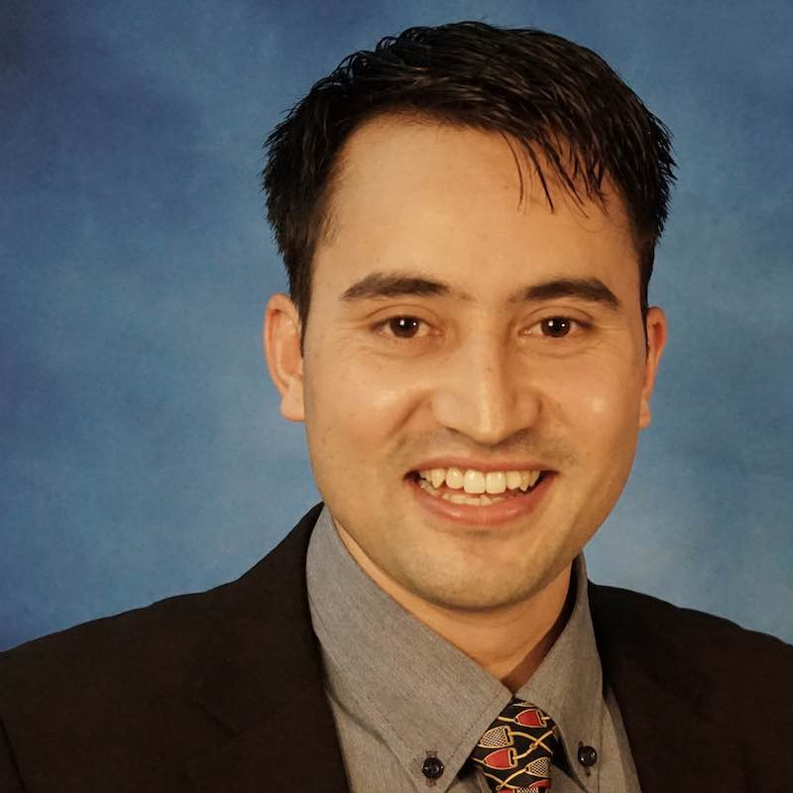
Kumar Aryal, Ph.D.
William Carey International University
“My PhD studies at WCIU equipped me to become a scholar-practitioner in the area of International Development. Today, I continue to read, write, publish, teach, speak, as well as lead a non-profit organization to alleviate poverty.”

Slide 17
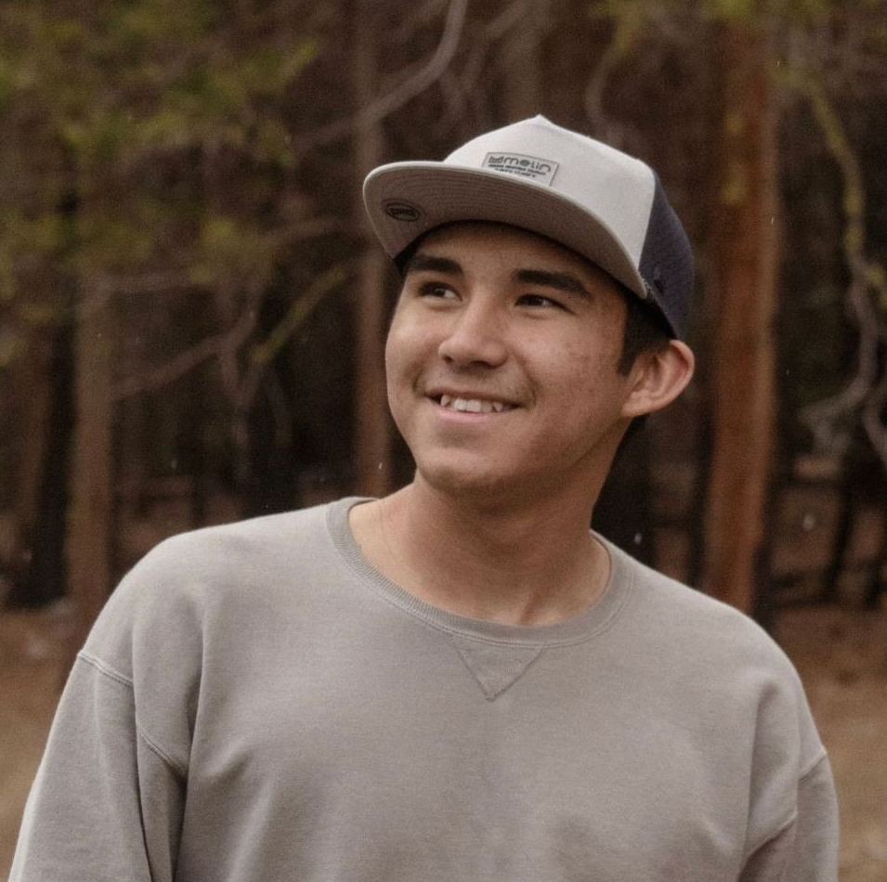
Wyatt Taylor
Penn Foster High School
“I help [others] when they doubt themselves because I used to doubt myself.”

Slide 18
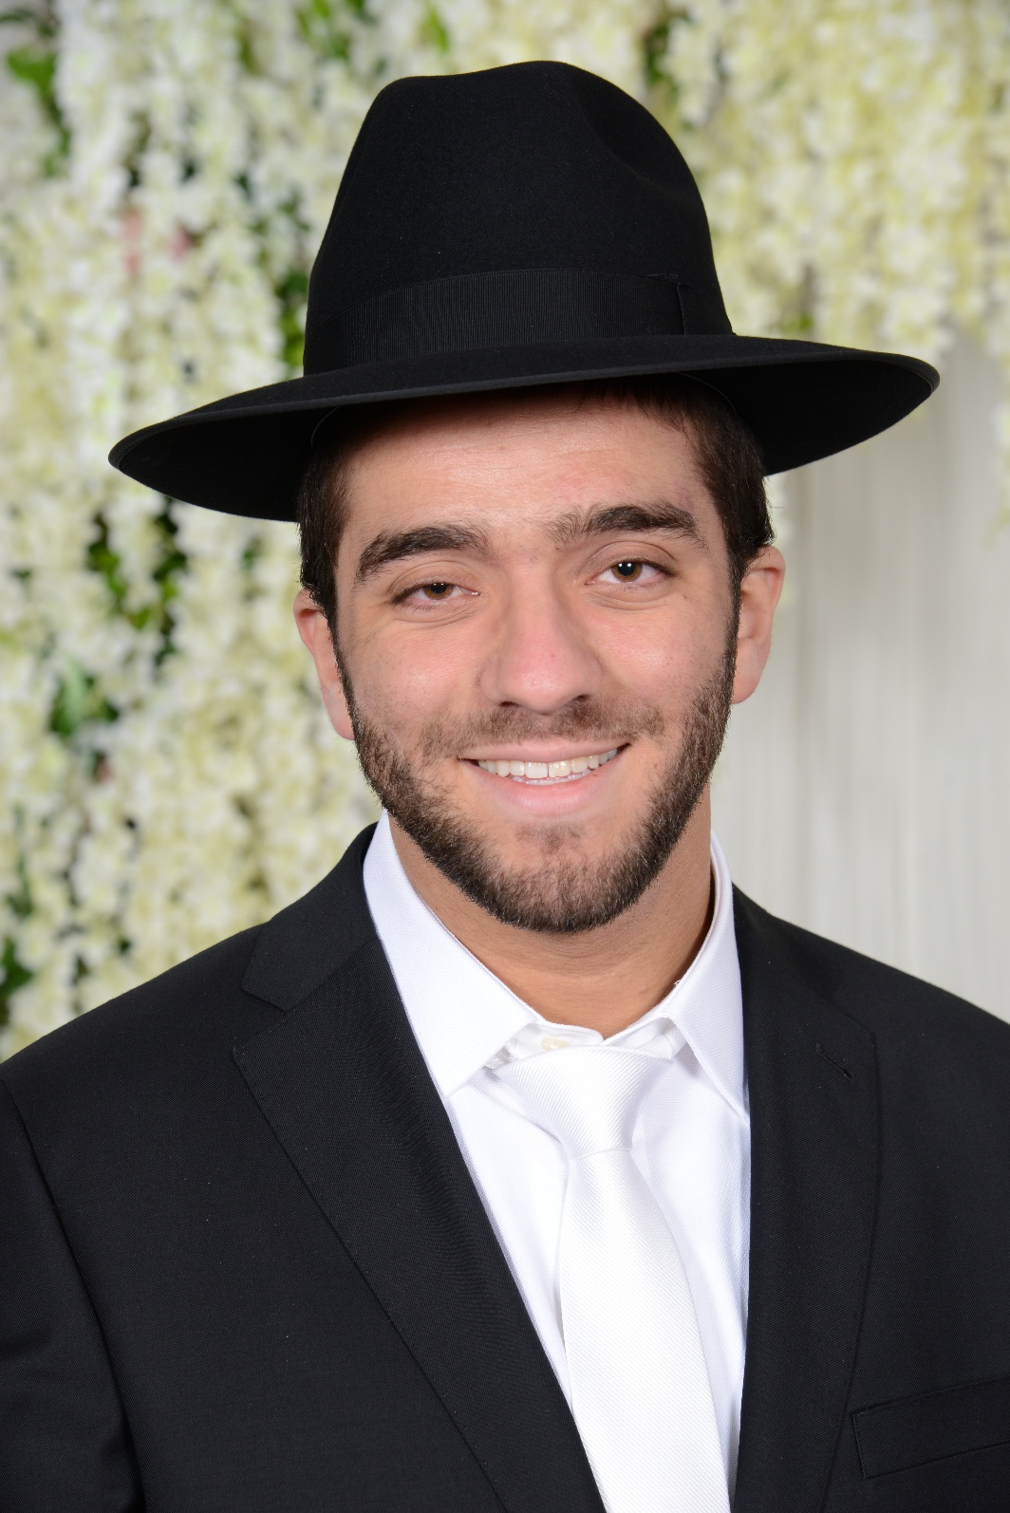
Yechiel Lefkowitz
Genesis University
“The ability to create a flexible undergraduate schedule has enabled me to pursue a law degree and has fundamentally changed how I view higher education.”

Slide 19
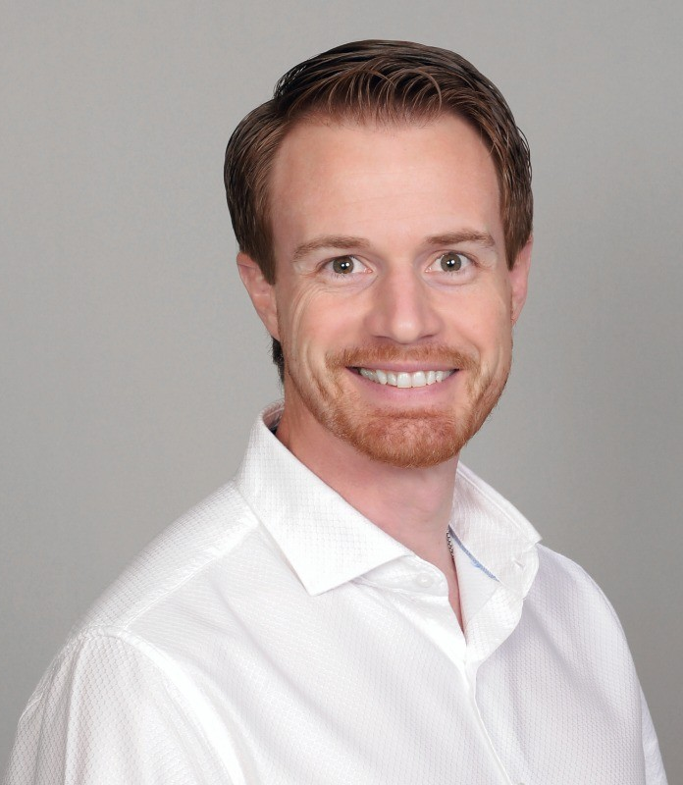
Jon Antonucci
Nations University
“I believe that servant-minded leadership, rooted in love, is the key to leaving a legacy that outlasts any business success. My passion is to equip dynamic, often-forgotten leaders with the skills, tools, and mindsets they need to thrive and grow.”

Slide 20
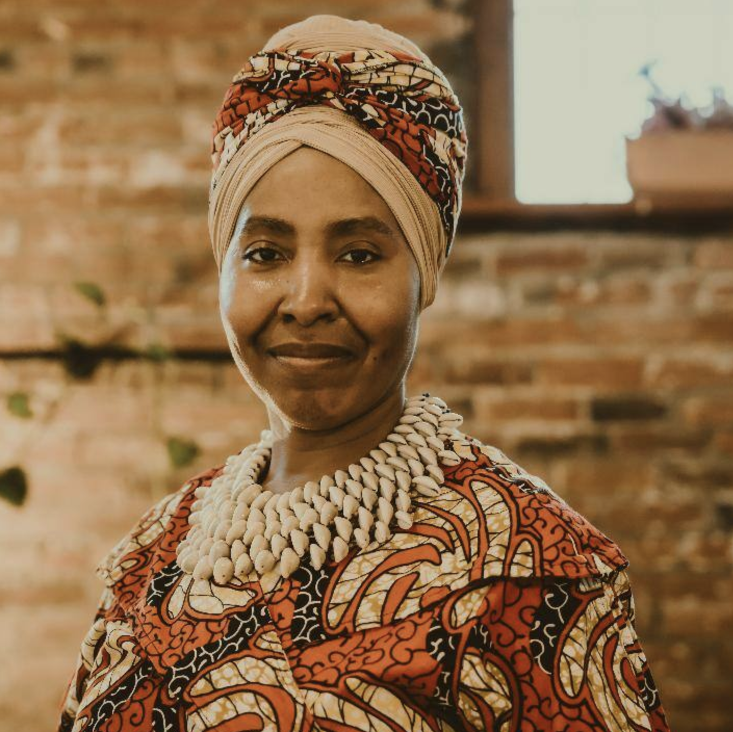
April Foster
American College of Healthcare Sciences
“Holistic wellness is about nurturing the body, mind, and spirit through integrative practices. My journey at ACHS has shown me the profound impact of embracing natural healing methods, and I am passionate about sharing these tools to empower others on their path to wellness.”

Slide 21
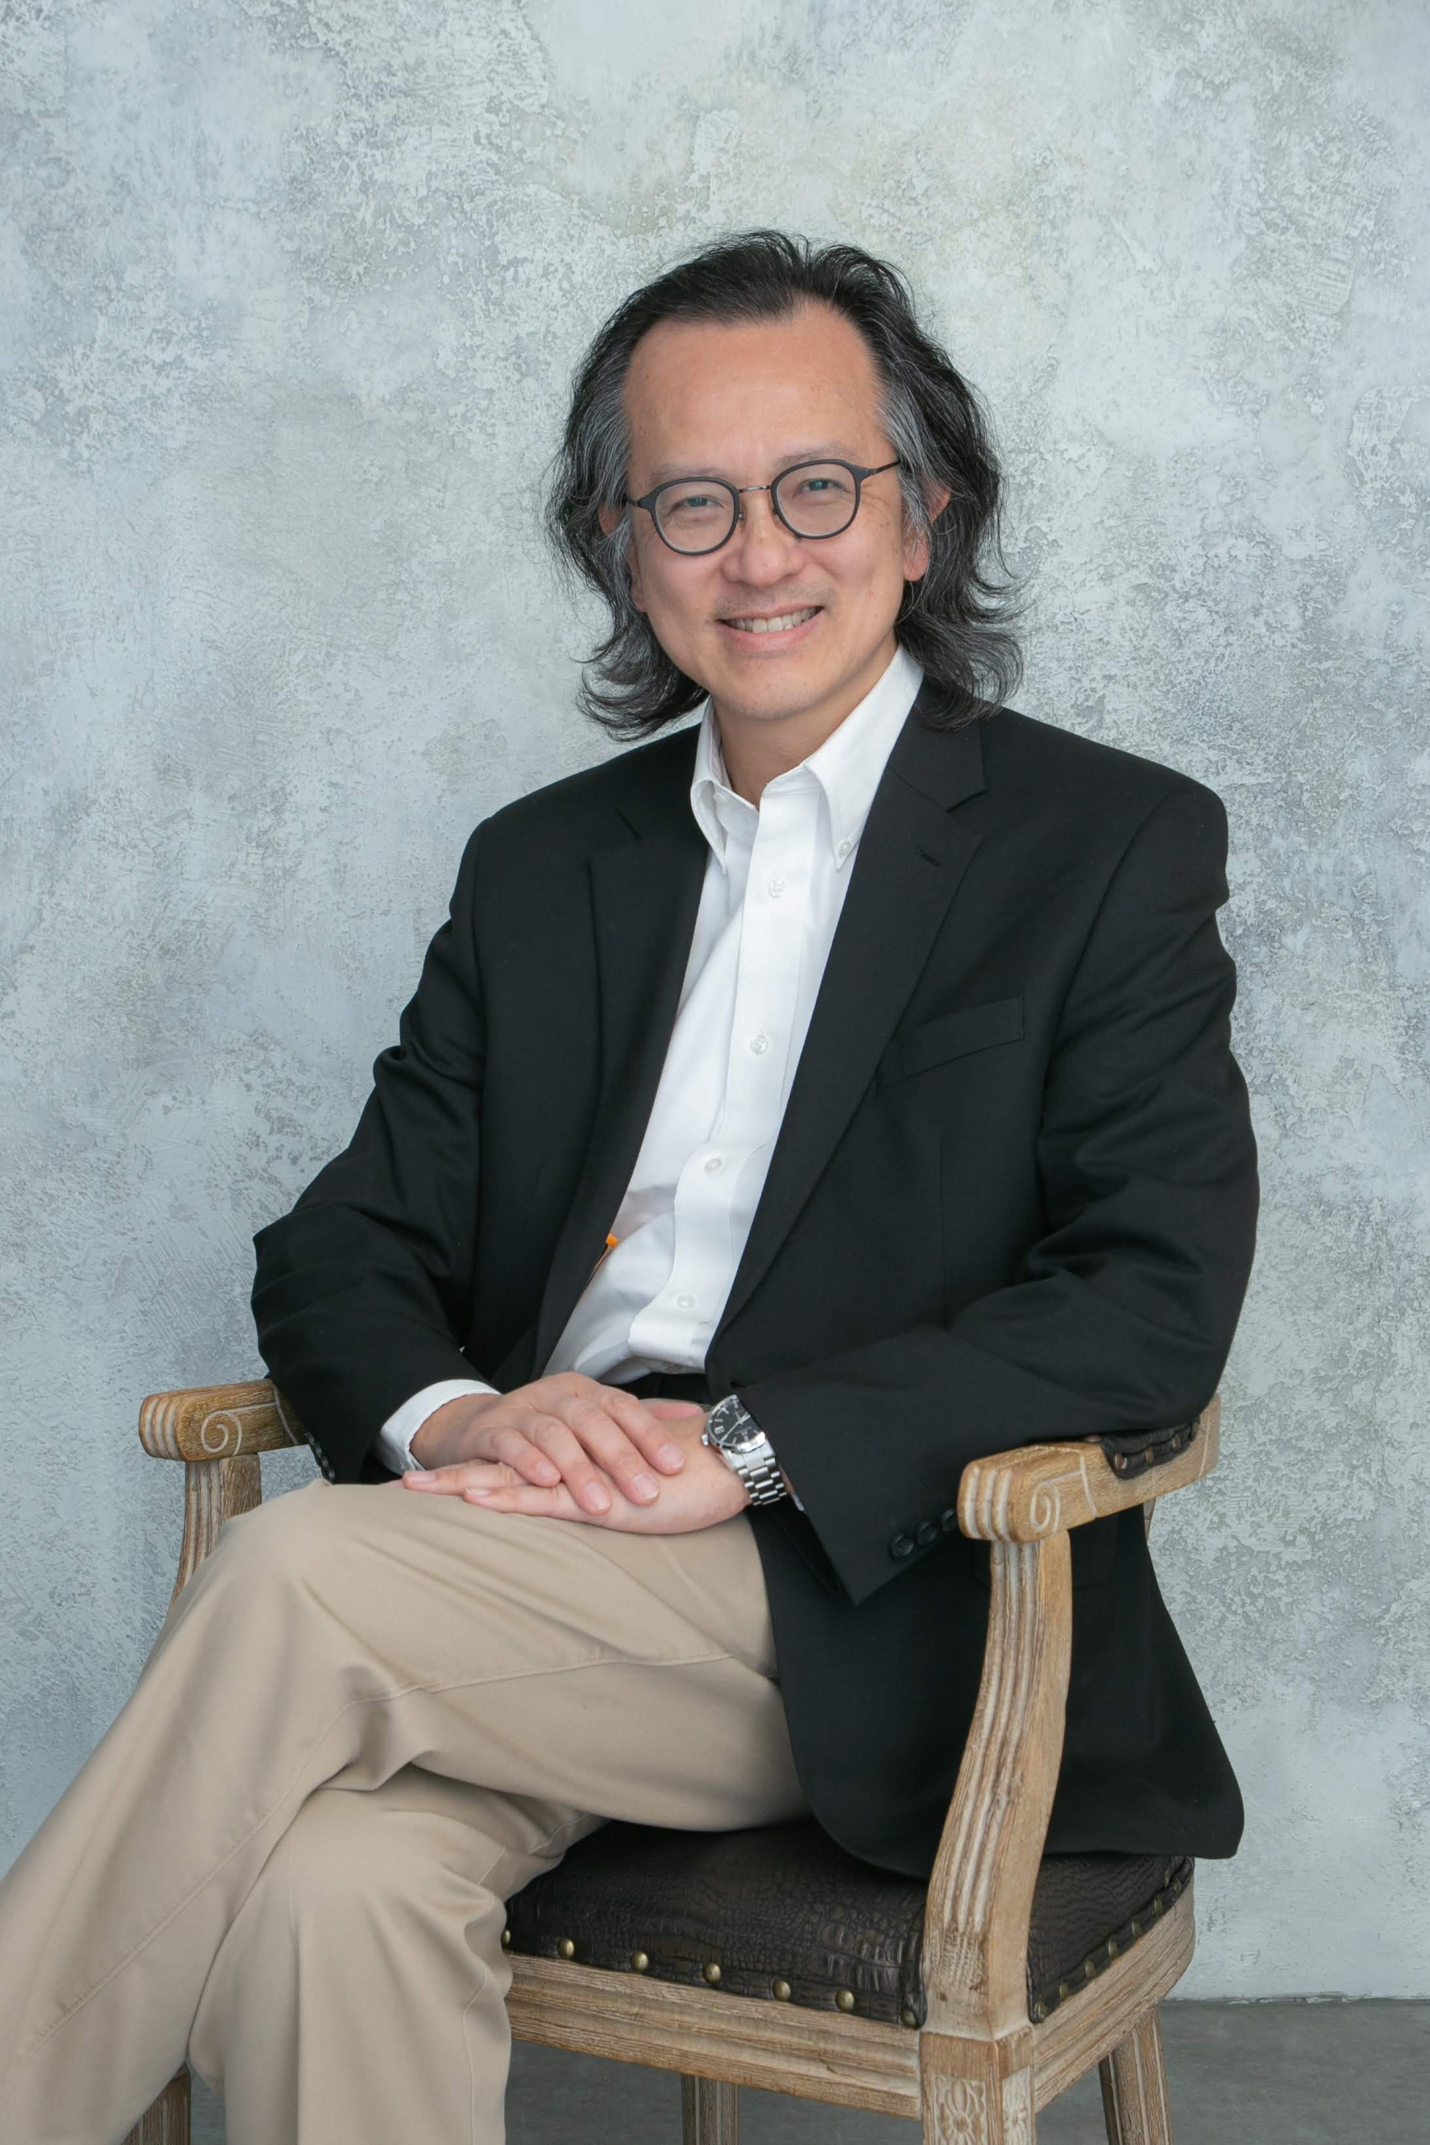
Dr. Danny Chung
University of Management and Technology
“The DBA program has strengthened my global perspective, allowing me to realize my vision in various community-focused and commercial projects. The opportunities ahead, along with the learnings from this DBA program, are both rewarding and transformative.”

Slide 22
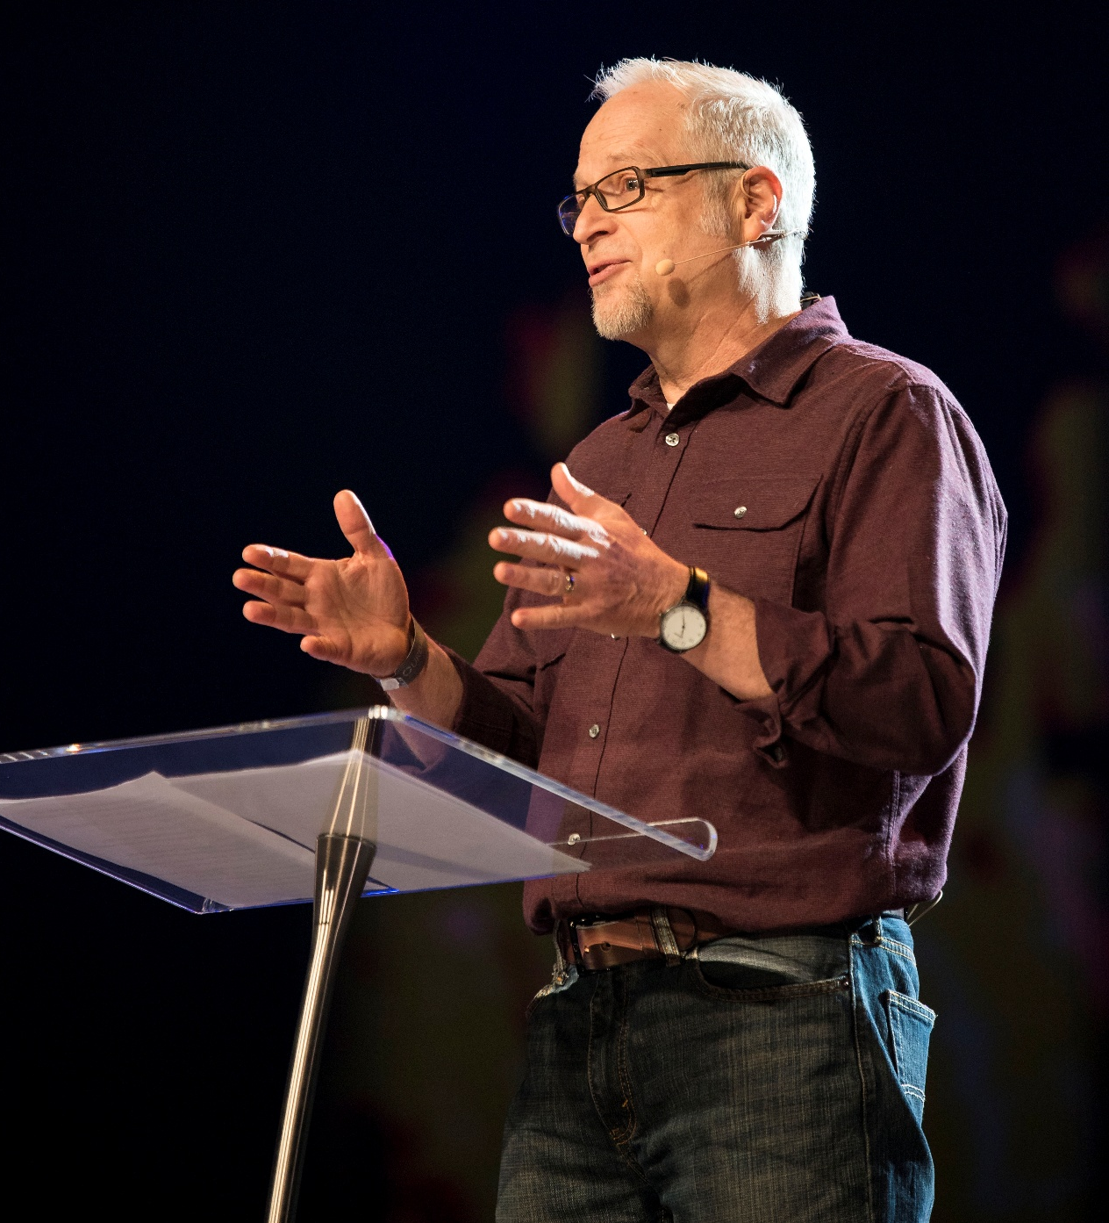
Scott Bessenecker
William Carey International University
As part of the Master’s Capstone project at William Carey International University, Scott designed the Global Urban Trek. This program continues to transform the lives of participants as they gain new insights through sharing life with people in vulnerable communities throughout the world.

Slide 23
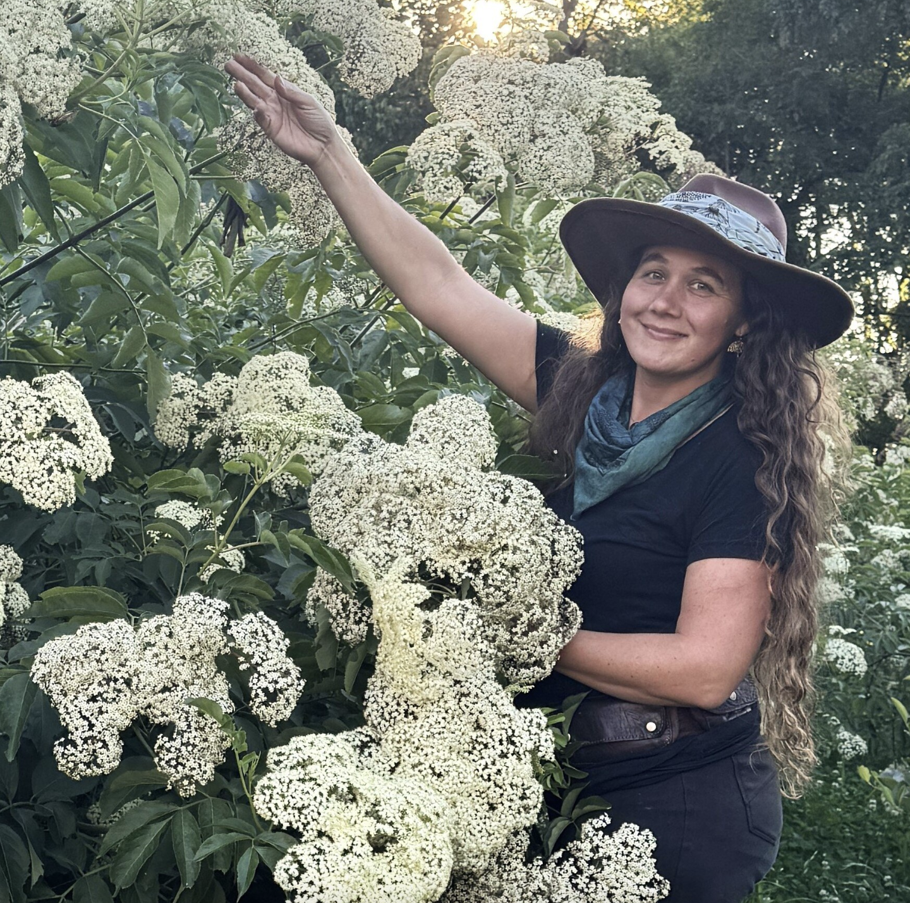
Crystal Moore-Stevens
American College of Healthcare Sciences
“The American College of Healthcare Sciences provided the foundation I needed to expand my work in herbal education and sustainable farming. With their support, I gained the confidence to dream big and create a life where I can share my passion for plants, healing, and earth stewardship with others.”

